Slide 1
Bioremediation of Strontium and Copper in water by Algae and Sea Urchins
Group: 1-34
Sun Yudong 4S120 Dominique Huynh AOS
Zheng Yu Bo 4S127 Sabrina Kim AOS

Slide 2
Contents
Introduction
Rationale & Objectives
Timeline
Materials and Apparatus
Methodology
Variables

Slide 3
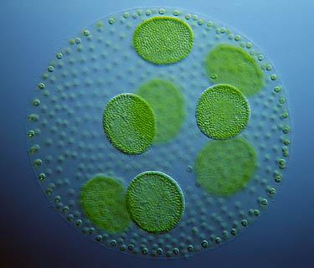
Introduction
Algae are a large group of photoautotrophic organisms
They can survive in various kinds of conditions and are extremely easy to grow.
(“Large-Scale Production of Biofuels Made From Algae Poses Sustainability Concerns; Further Innovations Needed to Reach Full Potential,” 2012)
Hence, algae are a very accessible resource, and can be readily used for bioremediation.
www.microscopy-uk.org.uk

Slide 4
Introduction
Heavy metal pollution is a serious problem that the world is facing today, with rapid industrialization
A remarkable increase in the use of heavy metals over the past few decades has inevitably resulted in an increased flux of metallic substances in the aquatic environment (Bishnoi, Anju, & Garima, 2004)
This poses a serious threat to the aquatic organisms’ health as heavy metals are highly toxic, and is quickly absorbed into the bodies of the organisms

Slide 5
Bioremediation
Bioremediation of heavy metal ions could involves two stages, physical adsorption and metabolism
Heavy metal ions are concentrated and can bind to the cellular structures of algae
Many potential binding sites occur in algal cell walls and alginate matrices for biosorption (Kumar & Oommen, 2010)

Slide 6
Biosorption
Physical adsorption
The process where the heavy metals are adsorbed into algae
Cell wall of green algae contains heteropolysaccharides, which offer carboxyl and sulfate groups for sequestration of heavy metal ions (Kumar & Oommen, 2010)
Metabolism
Mayaca fluviatilis Algae takes in heavy metal ions and metabolises it
Heavy metals such as Cu are essential micronutrients for algal metabolism (Bunghez, Ion, Dumitriu, & Fierascu, 2010)
Notes:
In the process of physical adsorption, heavy metal ions accumulated on the cell wall of the algae, which contains heteropolysaccharides that offer carboxyl and sulfate groups to accommodate these heavy metal ions.
However, since heavy metals such as copper are essential micronutrients and the Mayaca Algae has been found to take in heavy metal ions and metabolize it, we believe a process of metabolism also exist in the process of bioremediation of these heavy metal ions

Slide 7
Rationale
Spirogyra sp. has been known to have the ability to accumulate heavy metals such as Cadmium and Mercury (Kumar & Oommen, 2010)
We believe that the same can be achieved with marine green algae under the division Chlorophyta
Research has shown that marine algae Tetraselmis is able to remove Cadmium (Pérez-Rama, Abalde Alonso, Herrero López, & Torres Vaamonde, 2002)
We speculate that another marine algae Ulva will also be able to remove heavy metal ions
For this project, we will be investigating the effectiveness and efficiency of Ulva in absorbing heavy metal ions.
Notes:
Since the Mayaca Algae has been known to be able to bioremediate heavy metal ions, we believe that the same can be achieved with green algae, Chlorophyta.
Also, research has shown that 2 divisions of chlorophyta has demonstrated bioremediation properties. The marine algae Spirogyra Sp. is able to remove mercury and cadmium from water, while Tetraselmis is able to remove cadmium. We speculate that the same can be achieved with Ulva. Hence, we will be testing the effectiveness and efficiency of Ulva in bioremediating heavy metal ions.

Slide 8
Rationale
For this project, we will be working on:
Cu²⁺
Sr²⁺

Slide 9
Rationale
Cu²⁺ finds its way to water bodies through wastewater from Cu wire mills, coal burning industries, electroplating, tanning, smelting and refining, insecticides, fungicides, and iron and steel producing industries. (Bishnoi, Anju, & Garima, 2004)
Cu²⁺ is also a major component of anti-fouling paint on ship hulls
Unfortunately, many methods used to safely dispose of Cu²⁺ require high capital and recurring expenditures
Acceptable human threshold: 1.3 ppm (US EPA, n.d.)
Ocean: 0.00025 ppm in water and up to 100 ppm in sediments (Neal Blossom, n.d.)
Cu²⁺
Notes:
Many method are expensive ->non-optimal

Slide 10
Rationale
Strontium is released after a nuclear disaster
The concentrations found were up to 85 Bq·m⁻³ for ⁹⁰Sr and 265 Bq·m⁻³ for ⁸⁹Sr after Fukushima Daiichi incident (Casacuberta et al., 2013)
Sr²⁺ has similar electronic configuration as Ca²⁺ found in spines of sea urchins
AOS will be exploring the bioremediation of heavy metal ions using sea urchin
Absorbed into spines of sea urchins
Displaces Ca²⁺ in spines of sea urchins
Notes:
As for strontium, it is a common form of pollutant that is released after a nuclear disaster. In fact, after the Fukishima Daiichi incident, the concentration of radioactive isotopes of Strontium were up to 960 ppm and 265 Becquerel per meter cubed.
And since Strontium has a similar electronic configuration as the Calcium that is found in the spines of the sea urchins, we believe that Strontium will be taken up by these sea urchins spines.
However, experimentation with sea urchins will be explored by AOS, and we shall not elaborate further.

Slide 11
Objective
A study of the effect of biosorption of heavy metals ions using live and dead algae will be conducted.
A comparison between dead and live algae
The quantitative measurement of biosorption will be done through biosorption capacity and biosorption efficiency

Slide 12
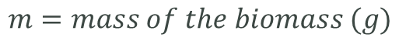

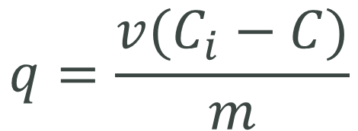
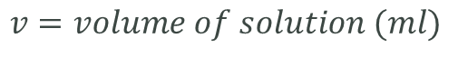
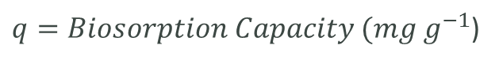
Biosorption Capacity
$$q=\frac{v(C_{i}−C)}{m}$$
$$Where$$
$q=Biosorption Capacity (mg g^{−1}$)
$$v=volume of solution (ml)$$
$$C_{i}=Initial Concentration of the solution (mg ml^{−1})$$
$$C=Final Concentration of the solution (mg ml^{−1})$$
$$m=mass of the biomass (g)$$
(Fu et al, 2012)

Slide 13

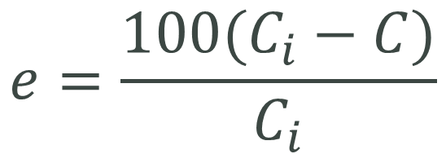
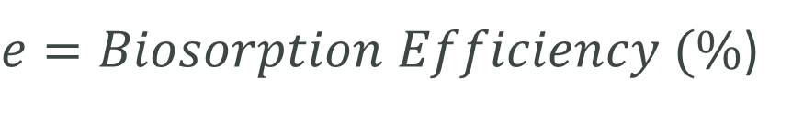
Biosorption Efficiency
$$e=\frac{100(C_{i}−C)}{C_{i}}$$
$$Where$$
$e=Biosorption Efficiency (\%$)
$$C_{i}=Initial Concentration of the solution (mg ml^{−1})$$
$$C=Final Concentration of the solution (mg ml^{−1})$$
(Fu et al, 2012)

Slide 14
Hypothesis
Live algae are better heavy metal bioremediators than dead algae

Slide 15
Project Timeline

Slide 16
Project Timeline
Obtain necessary materials and apparatus
Jan – March 2014
Cultivating Algae and preparing for prelims
Conduct experiments
17 Oct – 7 Nov Research on methodology and rationale of project (Literature Reviews)
8th Nov – 19 Nov
Discussion with AOS partners and finalize methodology
20th Nov – 31st Dec
Preliminary testing
Understand basic methodology through hands-on
Replicate results from literature review
March – July 2014
Experimentation and preparation for Semifinals

Slide 17
Methodology [Main Experimental Timeline]
Using Live algae
Using Dead & Harvested algae

Slide 18
Overview of Experimental Design
Live Algae → Biosorption at various concentrations of Cu²⁺ / Sr²⁺ solutions
Dried Algal Tissue → Biosorption at various concentrations of Cu²⁺ / Sr²⁺ solutions
Compare the results of the quantitative measurement of biosorption using the formulae for biosorption capacity and biosorption efficiency

Slide 19
Methodology [Using Live Algae]
Beyond 25 ppm, sea urchin spines will start to drop and they die (Bielmyer, Brix, Capo, & Grosell, 2005)
Copper (Cu²⁺)
Control: Instant Ocean
Maximum: 25 ppm
Human Threshold: 1.3 ppm
Strontium (Sr²⁺)
Control: Instant Ocean
Maximum: 960 ppm
Human Threshold: 13.74 ppm

Slide 20
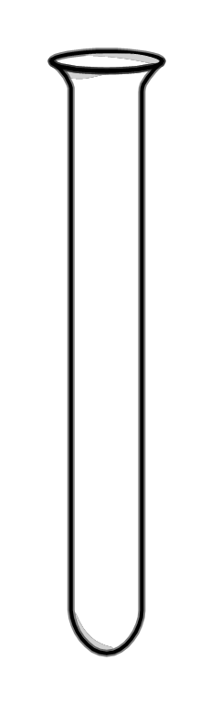
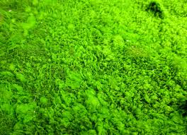
Methodology [Using Live Algae]
Cu²⁺
Sr²⁺
Acceptable Drinking water level
Maximum Worst-case scenario
Acceptable Drinking water level
Maximum Worst-case scenario
Control
Control
Instant Ocean
1.3 ppm Cu²⁺
25 ppm Cu²⁺
Instant Ocean
13.74 ppm Sr²⁺
960 ppm Sr²⁺

Slide 21
Methodology [Using Live Algae]
Colorimeter will be used to test amount of Cu²⁺ in solution
Spectrophotometer will be used to test amount of Sr²⁺ in solution with Xyelenol Orange at 570 nm
Comparison:
Initial Cu²⁺ ion concentration
Final Cu²⁺ ion concentration
Final concentration of Cu²⁺/Sr²⁺ in algae
This will be repeated 3 times, and measurement will be taken over a period of 5 days, and then until the maximum is reached with 1g of algae in 100ml of solution
Biosorption Capacity
Biosorption Efficiency

Slide 22
Variables [Using Live Algae]
Independent variable
Initial Concentration of Heavy Metal Ion Solution
Controlled Variable
Mass of live Algae used
Volume of water
Dependent Variable
Concentration of Heavy Metal Ion Solution over time
Temperature of surroundings
Temperature of solution
Amount of light available
Time interval between each measurement
Type of heavy metal ions

Slide 23
Methodology [Using Dead & Harvested Algae]
Dry live algae until no further change in dry mass
Submerge algae in 1% Mass-to-volume ratio of concentrated heavy metal solution for 5 days.
Change in concentration of heavy metal ions are recorded over time
Centrifuge and test supernatant
Notes:
THIS SLIDE CANNOT SKIP!

Slide 24
Methodology [Using Dead & Harvested Algae]
Cu²⁺
Sr²⁺
Acceptable Drinking water level
Maximum Worst-case scenario
Acceptable Drinking water level
Maximum Worst-case scenario
Control
Control
Instant Ocean
1.3 ppm Cu²⁺
25 ppm Cu²⁺
Instant Ocean
13.74 ppm Sr²⁺
960 ppm Sr²⁺

Slide 25
Variables [Using Dead & Harvested Algae]
Independent variable
Initial Concentration of Heavy Metal Ion Solution
Controlled Variable
Mass of Dead & Harvested Algae used
Volume of water
Dependent Variable
Concentration of Heavy Metal Ion Solution over time
Temperature of surroundings
Temperature of solution
Time interval between each measurement
Type of heavy metal ions

Slide 26
Methodology [Using Dead & Harvested Algae]
Colorimeter will be used to test amount of Cu²⁺ in solution
Spectrophotometer will be used to test amount of Sr²⁺ in solution
Comparison:
Initial water concentration
Final water concentration
Final concentration of Cu²⁺/Sr²⁺ in dead algae
This will be repeated 3 times
Biosorption Capacity
Biosorption Efficiency

Slide 27
Methodology [Comparison of living/dead algae]
Results from dead algae tests
Comparison
Results from live algae tests
Through the comparison, we can find out:
The mechanism of removal of heavy metal ions by Algae
Whether live algae or dead algae is a better bioremediator

Slide 28
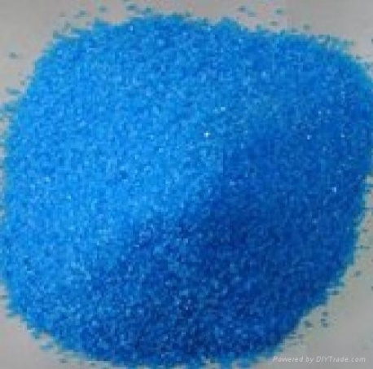
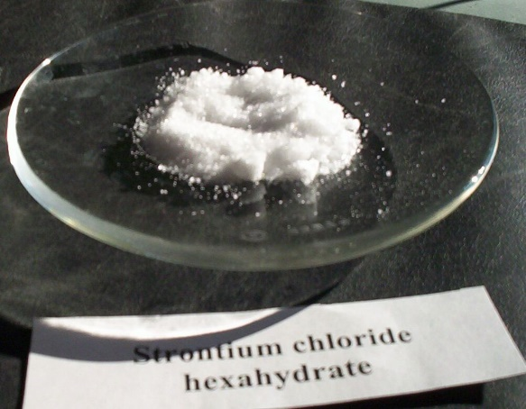
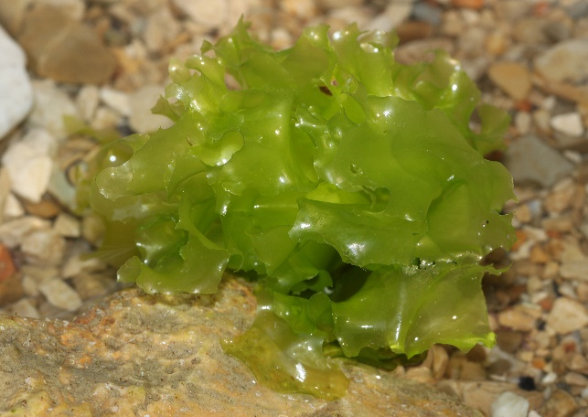
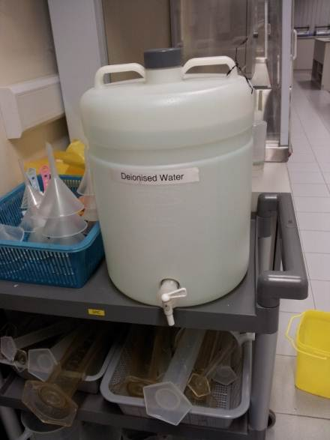
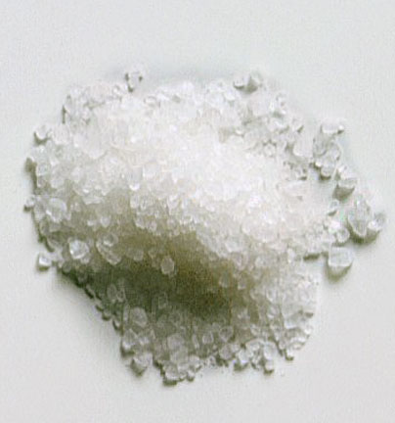
Materials
Copper(II) Sulfate pentahydrate
Strontium chloride hexahydrate
Ulva
Deionized water
Instant Ocean/ Sea Salt
de.wikipedia.org
img.diytrade.com
en.wikipedia.org
www.topnews.in

Slide 29
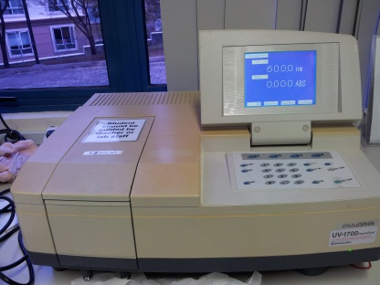
Apparatus
Spectrophotometer
Tanks
Pumps
Lights
Colorimeter
Air Conditioner
Conical flask
Rotary shaker
Centrifuge
Oven
Notes:
Photos to be taken in lab after returning

Slide 30
Applications
Through the use of live organisms instead of chemicals, the following can be achieved at low cost and without huge impact to the habitat:
Remediation in nuclear polluted waters containing Strontium
Remediation of polluted wastewaters due to improper water treatment processes

Slide 31
Applications
For commercial application of algal technology for optimal metal removal from wastewater, the emphasis needs to be on:
Selection of strain with high metal sorption capacity
Adequate understanding of sorption mechanisms
Development of better models for predicting metal sorption
Genetic manipulation of algae for increased number of surface groups or over expression of metal binding proteins
Economic feasibility
(Mehta & Gaur, 2005)

Slide 32
References
Bielmyer, G. K., Brix, K. V., Capo, T. R., & Grosell, M. (2005). The effects of metals on embryo-larval and adult life stages of the sea urchin, Diadema antillarum. Aquatic toxicology (Amsterdam, Netherlands), 74(3), 254–263. doi:10.1016/j.aquatox.2005.05.016
Bioconcentration factors (BCFs) for aquatic organisms. (n.d.). Retrieved from http://uwrl.usu.edu/www/doucette/6730/CEE%205730%20BCF%20lec%209-1.pdf
Bishnoi, N. R., Anju, P., & Garima. (2004). Biosorption of copper from aqueous solution using algal biomass. Journal of Scientific & Industrial Research, 63(October 2004), 813–816.
Bunghez, I.-R., Ion, R.-M., Dumitriu, I., & Fierascu, R.-C. (2010). Heavy Metal Ions Depollution by Marine Natural Products. Journal of Science and Arts, 1(12), 73–78.
Casacuberta, N., Masque, P., Garcia-Orellana, J., Garcia-Tenorio, R., & Buesseler, K. O. (2013). 90Sr and 89Sr in seawater oﬀ Japan as a consequence of the Fukushima Dai-ichi nuclear accident. Biogeosciences, 10, 3649–3659. doi:10.5194/bg-10-3649-2013
Fu, Y. Q., Li, S., Zhu, H. Y., Jiang, R., & Yin, L. F. (2012). Biosorption of copper from aqueous solutions by mycelial pellets of rhizopus oryzae. African Journal of Biotechnology, 11(6), 1403–1411.
Kumar, J. I. N., & Oommen, C. (2010). Removal of heavy metals by biosorption using freshwater alga Spirogyra hyalina. Journal of Environmental Biology, (January 2012), 27 – 31.
Large-Scale Production of Biofuels Made From Algae Poses Sustainability Concerns; Further Innovations Needed to Reach Full Potential. (2012, October 24). National-Academies.org | Newsroom. Retrieved November 9, 2013, from http://www8.nationalacademies.org/onpinews/newsitem.aspx?RecordID=13437
Mehta, S. K., & Gaur, J. P. (2005). Use of algae for removing heavy metal ions from wastewater: progress and prospects. Critical reviews in biotechnology, 25(3), 113–152. doi:10.1080/07388550500248571
Neal Blossom. (n.d.). Copper in the Ocean Environment.
Pérez-Rama, M., Abalde Alonso, J., Herrero López, C., & Torres Vaamonde, E. (2002). Cadmium removal by living cells of the marine microalga Tetraselmis suecica. Bioresource Technology, 84(3), 265–270. doi:10.1016/S0960-8524(02)00045-7
Suresh, B., & Ravishankar, G. A. (2004). Phytoremediation--a novel and promising approach for environmental clean-up. Critical reviews in biotechnology, 24(2-3), 97–124. doi:10.1080/07388550490493627
US EPA, O. (n.d.). Basic Information about Copper in Drinking Water. Retrieved November 15, 2013, from http://water.epa.gov/drink/contaminants/basicinformation/copper.cfm

Slide 33

Any
Questions?

